Slide 1
CREDIT CARD FRAUD DETECTION USING HIDDEN MARKOV MODELS
A Term Project for course
Introduction to Stochastic Processes and Their Applications (IME625A)
By
Ashwin Ashok Kumar
Danish Nawaz
Dhruv Patel
Paras Arora
Guided By:
Prof. Avijit Khanra

Slide 2
Introduction:
In this project, we studied how to model the sequence of operations in credit card transaction processing using a Hidden Markov Model (HMM) and showed how it can be used for the detection of frauds. An HMM is initially trained with the normal behaviour of a cardholder. If an incoming credit card transaction is not accepted by the trained HMM with sufficiently high probability, it is considered to be fraudulent. At the same time, we try to ensure that genuine transactions are not rejected.

Slide 3
What is HMM?
Graphical Model
Circles indicate states
Arrows indicate probabilistic dependencies between states

Slide 4
What is an HMM?
Green circles are hidden states
Dependent only on the previous state
“The past is independent of the future given the present.”

Slide 5
What is HMM?
Purple nodes are observed states
Dependent only on their corresponding hidden state

Slide 6
HMM Specification
A
A
A
A
ω
ω
ω
ω
ω
B
B
B
V
V
V
V
V
{ω,V, Π, Α, Β}
Π = {π_{ι}} are the initial state probabilities
A = {a_{ij}} are the state transition probabilities
B = {b_{ik}} are the observation state probabilities

Slide 7
Central Issues in HMM
Compute the probability of a given observation sequence (Evaluation Problem)
Given an observation sequence, compute the most likely hidden state sequence (Decoding Problem)
Given an observation sequence and set of possible models, which model most closely fits the data (Learning Problem)

Slide 8
Evaluation Problem
Evaluation problem. Given the HMM θ = (W, V, a_{ij}, b_{jk}) and the observation sequence V^{T} calculate the probability that model θ has generated sequence V^{T}.
Trying to find probability of observations V^{T} by means of considering all hidden state sequences is impractical because order of complexity is N^{T}.
So we use Forward Algorithm for efficient calculations.

Slide 9
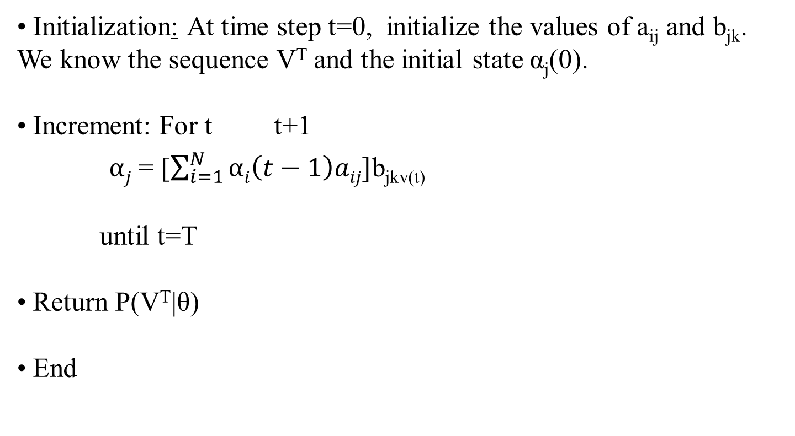
Forward Algorithm for HMM

Slide 10
Representation of Forward Algorithm
V₁ V_{k} V_{k+1} V_{K} = Observations
ω₁
ω₁
ω₁
ω₁
ω₂
ω₂
a_{1j}
ω₂
ω₂
a_{2j}
ω_{i}
ω_{i}
ω_{j}
ω_{i}
a_{ij}
a_{Nj}
ω_{N}
ω_{N}
ω_{N}
ω_{N}
Time= 1 k k+1 K

Slide 11
Learning Problem
Given a large number of observation sequences V^{T} and the set of possible states in HMM, we need to learn the HMM parameters A and B.
Standard algorithm for HMM training is Forward Backward algorithm.

Slide 12
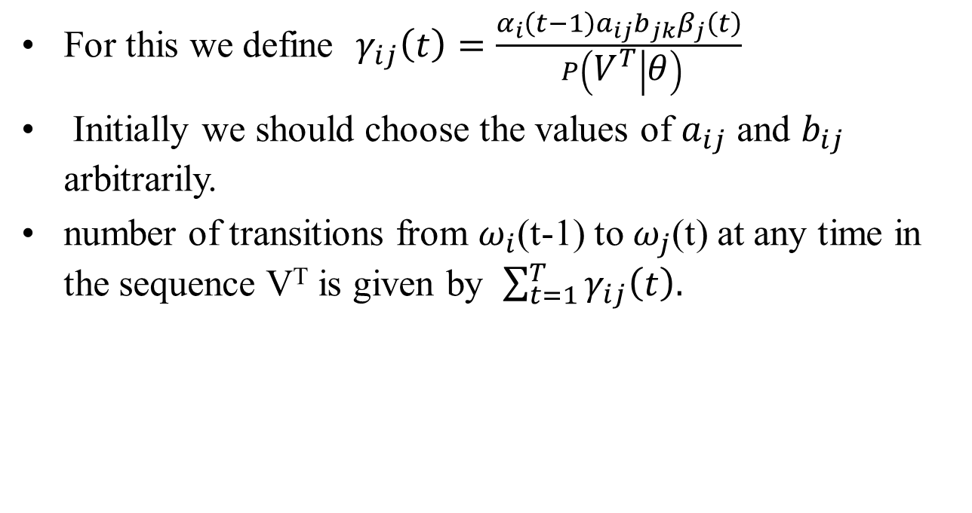
Forward Backward algorithm
For this we define $γ_{ij}\left(t\right)=\frac{α_{i}\left(t−1\right)a_{ij}b_{jk}β_{j}\left(t\right)}{ P\left(V^{T} | θ\right)}$
Initially we should choose the values of $a_{ij}$ and $b_{ij}$ arbitrarily.
number of transitions from $ω_{i}$(t-1) to $ω_{j}$(t) at any time in the sequence V^{T} is given by $\sum_{t=1}^{T}{γ_{ij}\left(t\right).}$

Slide 13
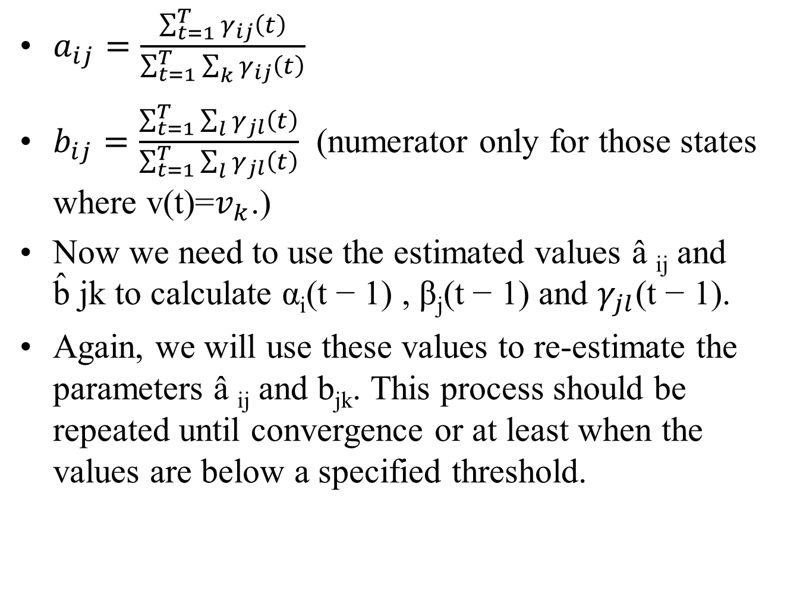
$a_{ij}=\frac{\sum_{t=1}^{T}{γ_{ij}\left(t\right)}}{\sum_{t=1}^{T}{\sum_{k}{γ_{ij}\left(t\right)}}}$
$b_{ij}=\frac{\sum_{t=1}^{T}{\sum_{l}{γ_{jl}\left(t\right)}}}{\sum_{t=1}^{T}{\sum_{l}{γ_{jl}\left(t\right)}}}$ (numerator only for those states where v(t)=$v_{k}$.)
Now we need to use the estimated values â _{ij} and b̂ jk to calculate α_{i}(t − 1) , β_{j}(t − 1)and $γ_{jl}$(t − 1).
Again, we will use these values to re-estimate the parameters â _{ij} and b_{jk}. This process should be repeated until convergence or at least when the values are below a specified threshold.

Slide 14
USE OF HMM FOR CREDIT CARD FRAUD DETECTION
Observable states: Purchase values (Clustered Dynamically)
Hidden States: Type of Purchase, as information about the merchant’s line of business is not known to the issuing bank running the FDS. Thus, the type of purchase of the cardholder is hidden from the FDS. The set of all possible types of purchase and, equivalently, the set of all possible lines of business of merchants forms the set of hidden states of the HMM.

Slide 17
Steps:
Training of HMM using past transactions, and initial parameter estimates.
After training, for each incoming transaction O_{R+1} we find α₁=P (O₁, O₂, O₃, …O_{R}| λ) and α₂= P (O₂, O₃, O₄ …O_{R+1}| λ) .
If Δ α / α₁ ≥ Threshold., then we declare O_{R+1} as malicious and issuing bank rejects the transaction
Otherwise, O_{R+1} is added in the sequence permanently, and the new sequence is used as the base sequence for determining the validity of the next transaction.

Slide 18
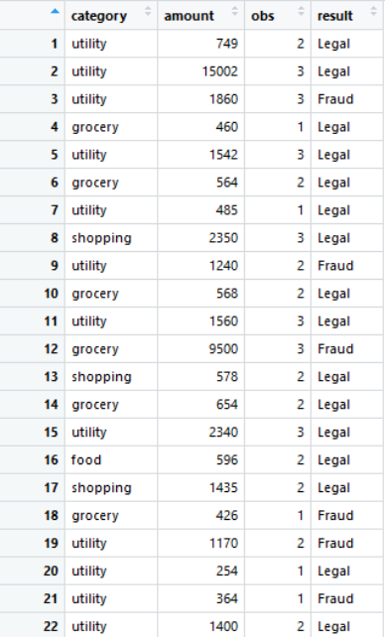
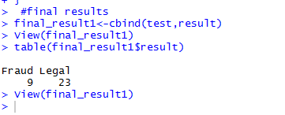
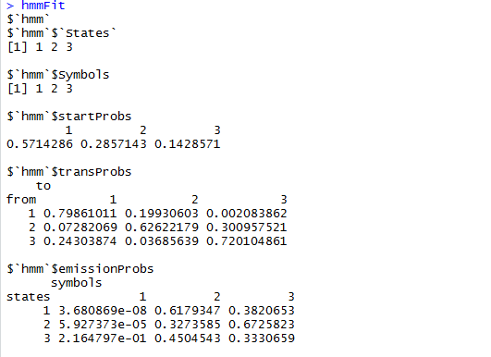
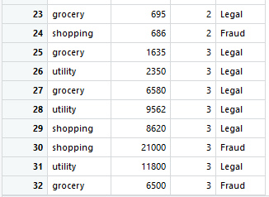
Example:
Test Data Results:

Slide 19
Thank You.

